Slide 1
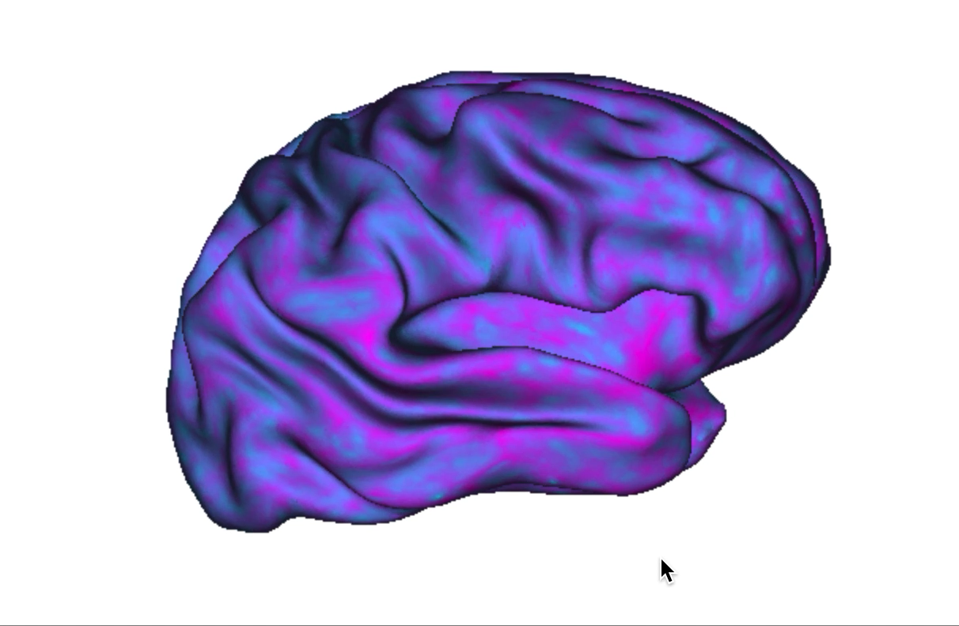
Neuropythy for Dev
Neurohackademy 2019
Maya Rosen, Kendra Seaman, Aarti Nair,
Megan McMahon, Leehyun Yoon

Slide 2


The Plan
Download the HCP-Lifespan Dataset
Run HCP preprocessing pipelines using a docker container on AWS
Use Neuropythy to visualize age-related differences in structural properties:
cortical thickness
gyrification
T1/T2 differences

Slide 3
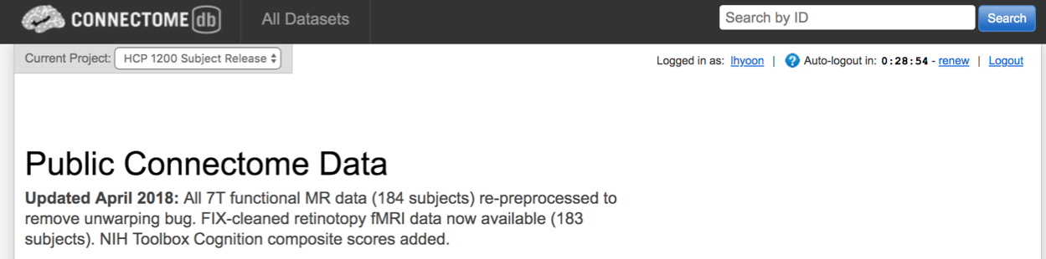
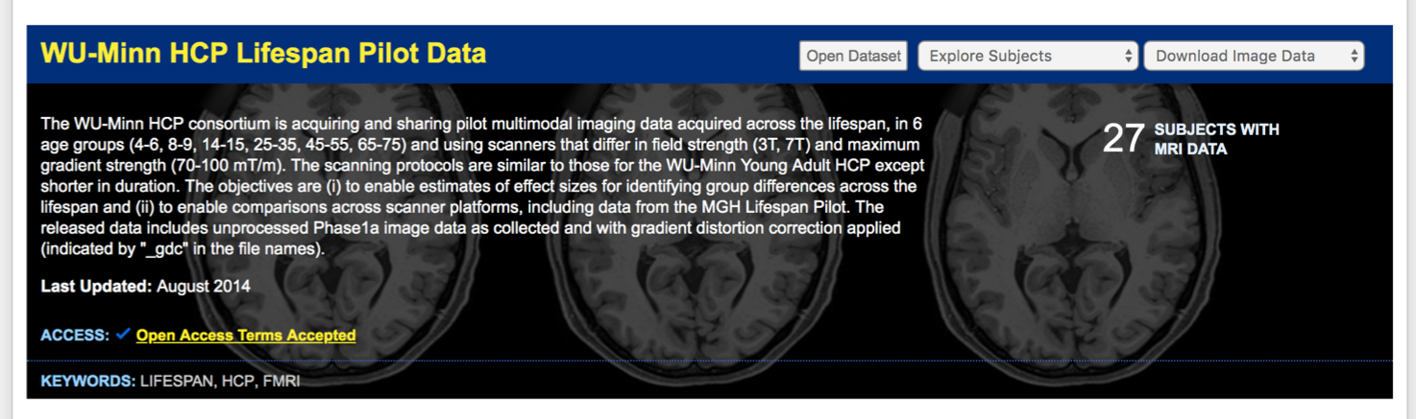
Monday: Download the HCP-D and HCP-A Datasets
HCP-Lifespan Pilot Data
ABCD Data

Slide 4


Tuesday: Upload the data to AWS and run the HPC Pipeline

Slide 5


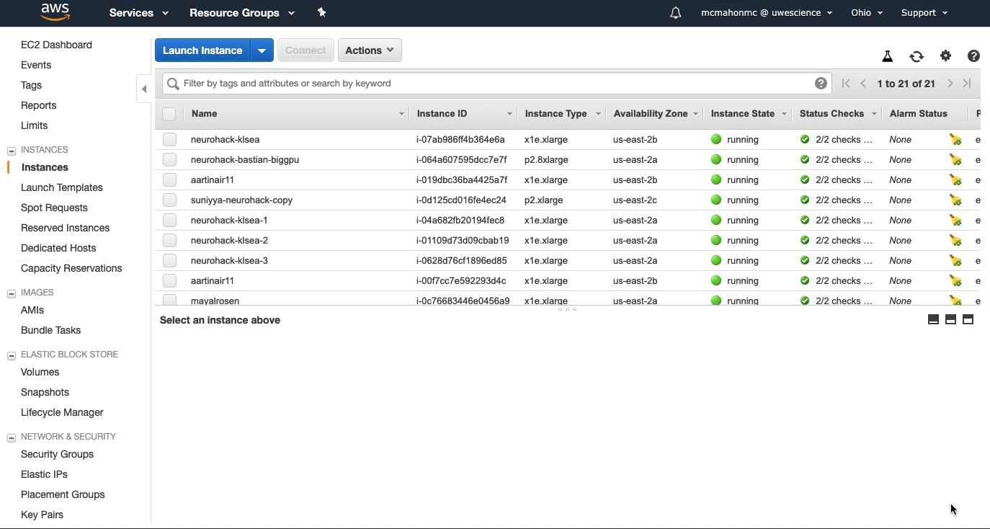
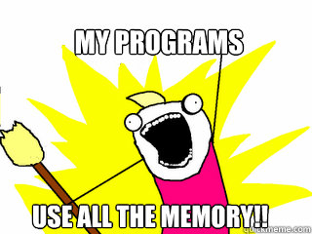

Wednesday: BIDS the data and run the HPC Pipeline

Slide 6
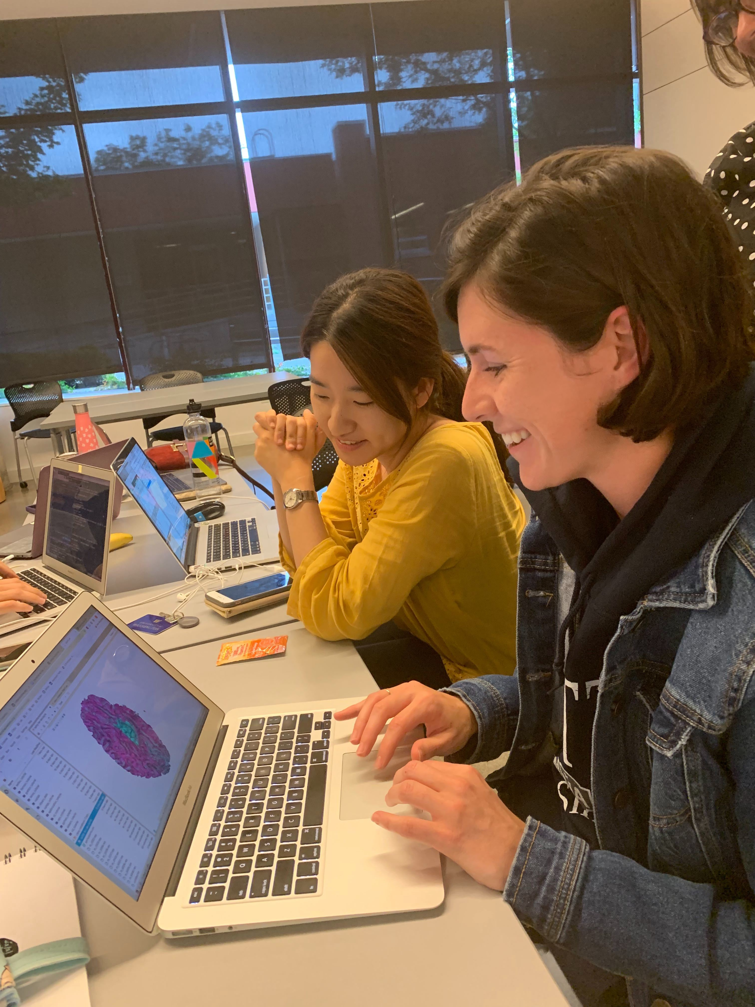
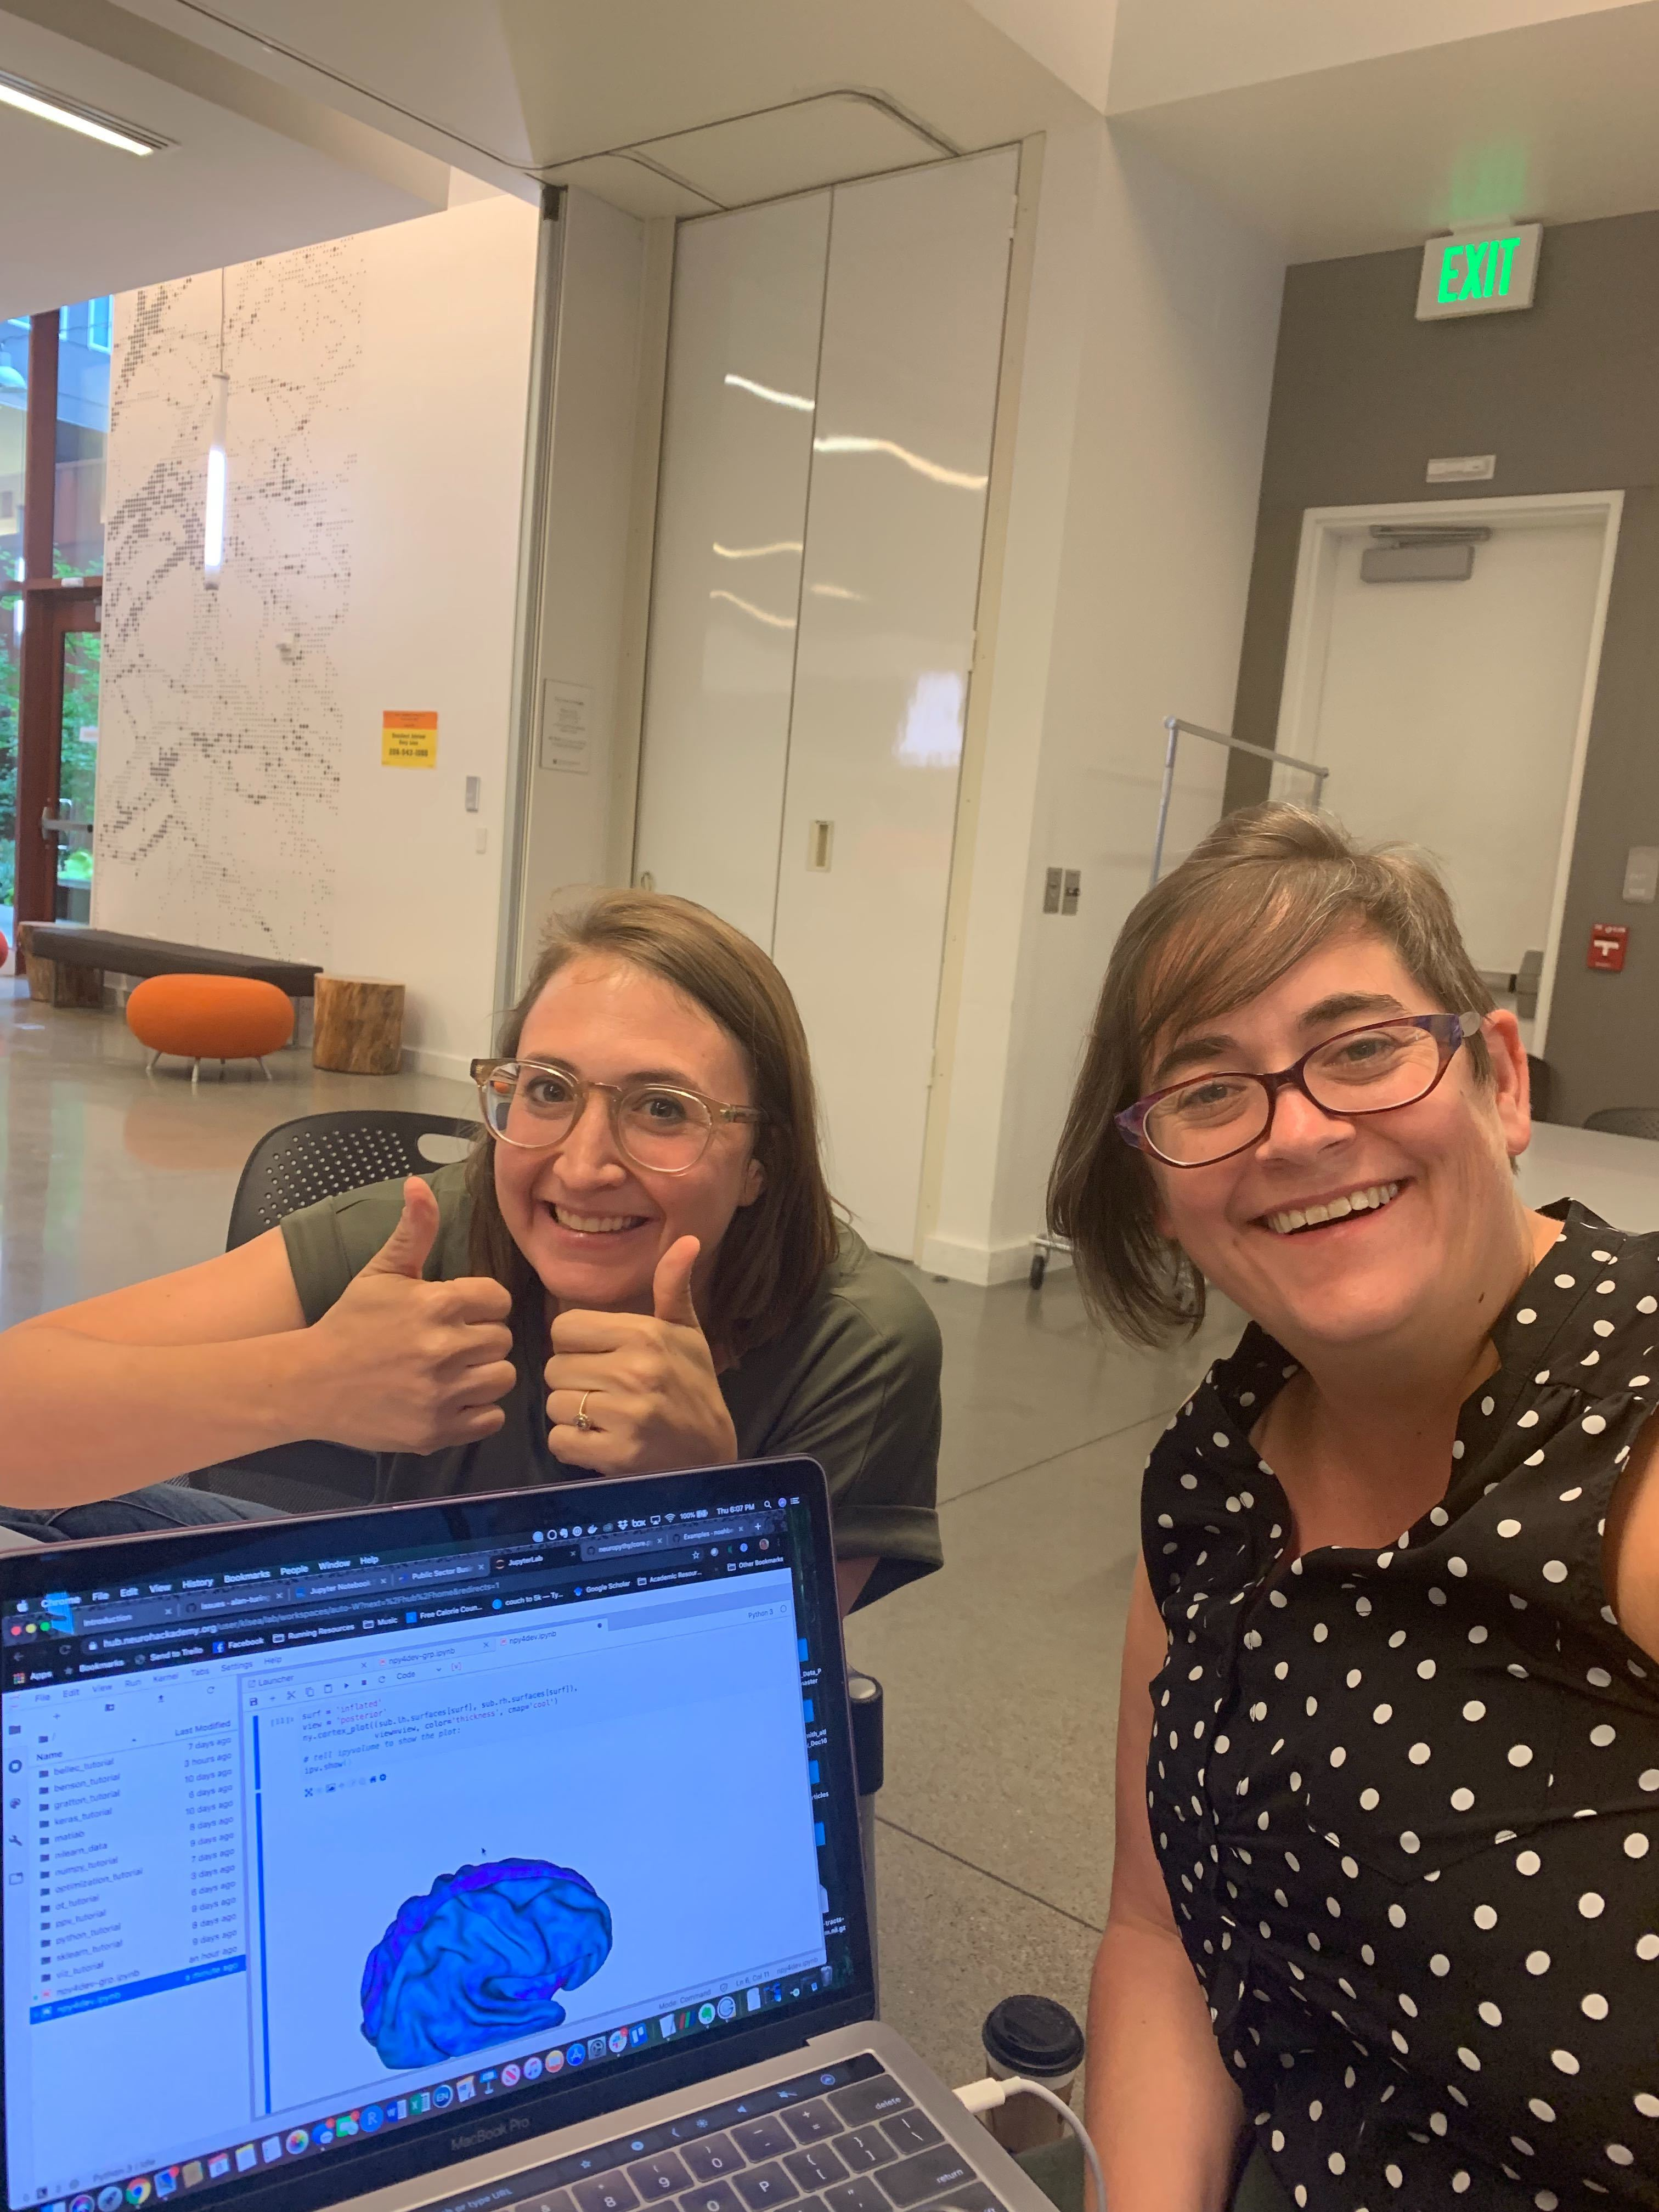
Thursday: Look at a single subject in Neuropythy

Slide 7
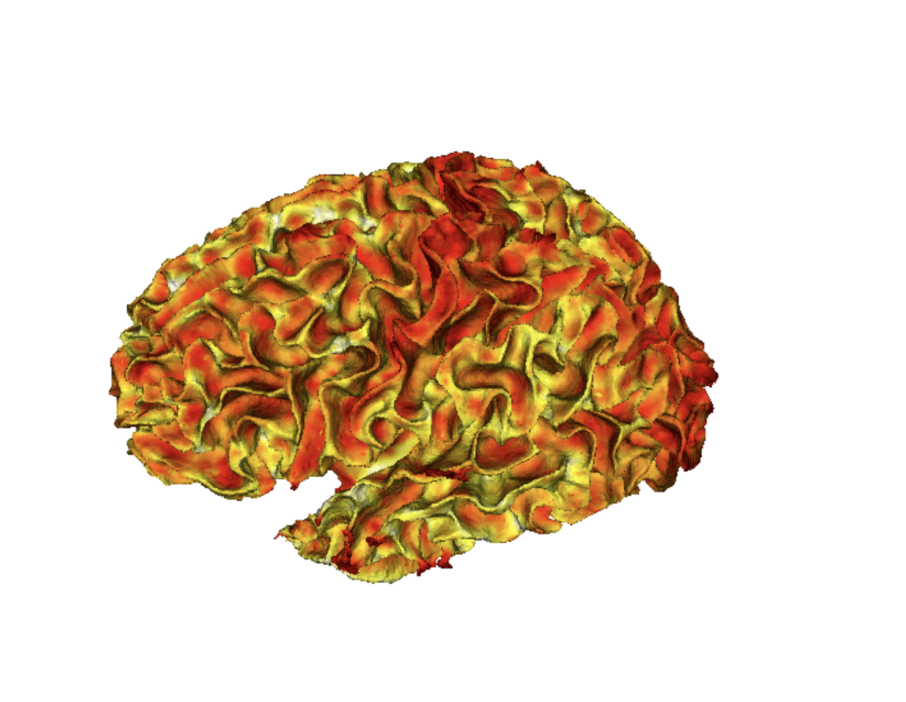
Jupyter Notebook 1 – 8-9 year old

Slide 8
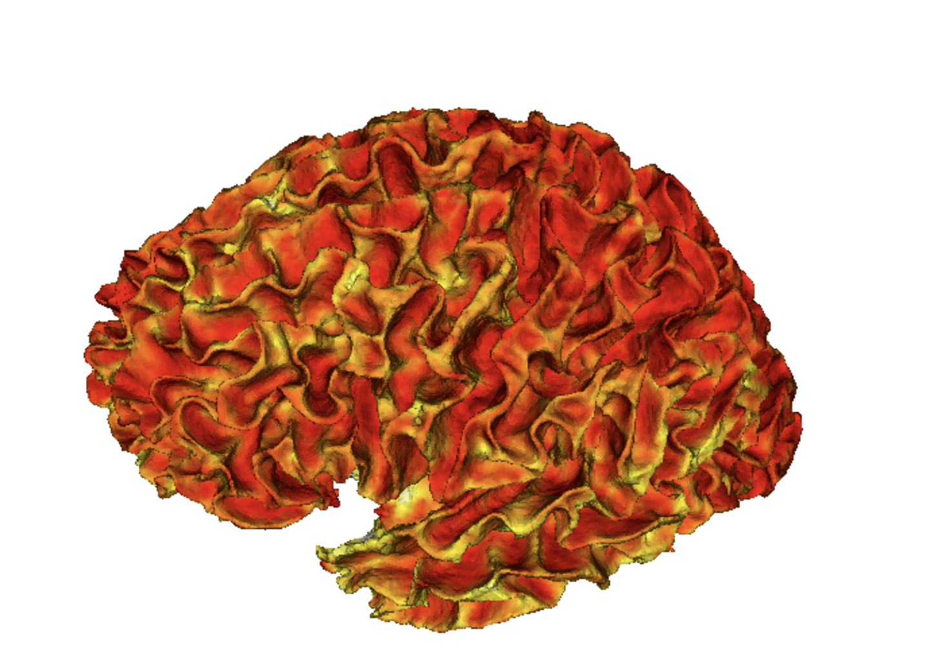
Jupyter Notebook 2 – 65-75 year old

Slide 9



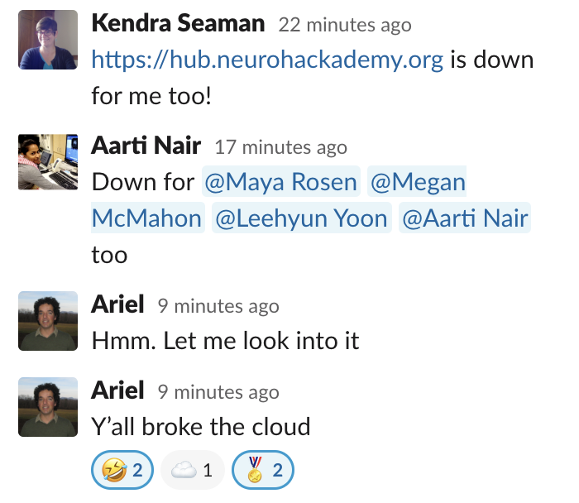

Thursday: Run group-level analyses in Neuropythy… or anything
!

Slide 10


Thursday: Run group-level analyses in Neuropythy… or anything

Slide 11

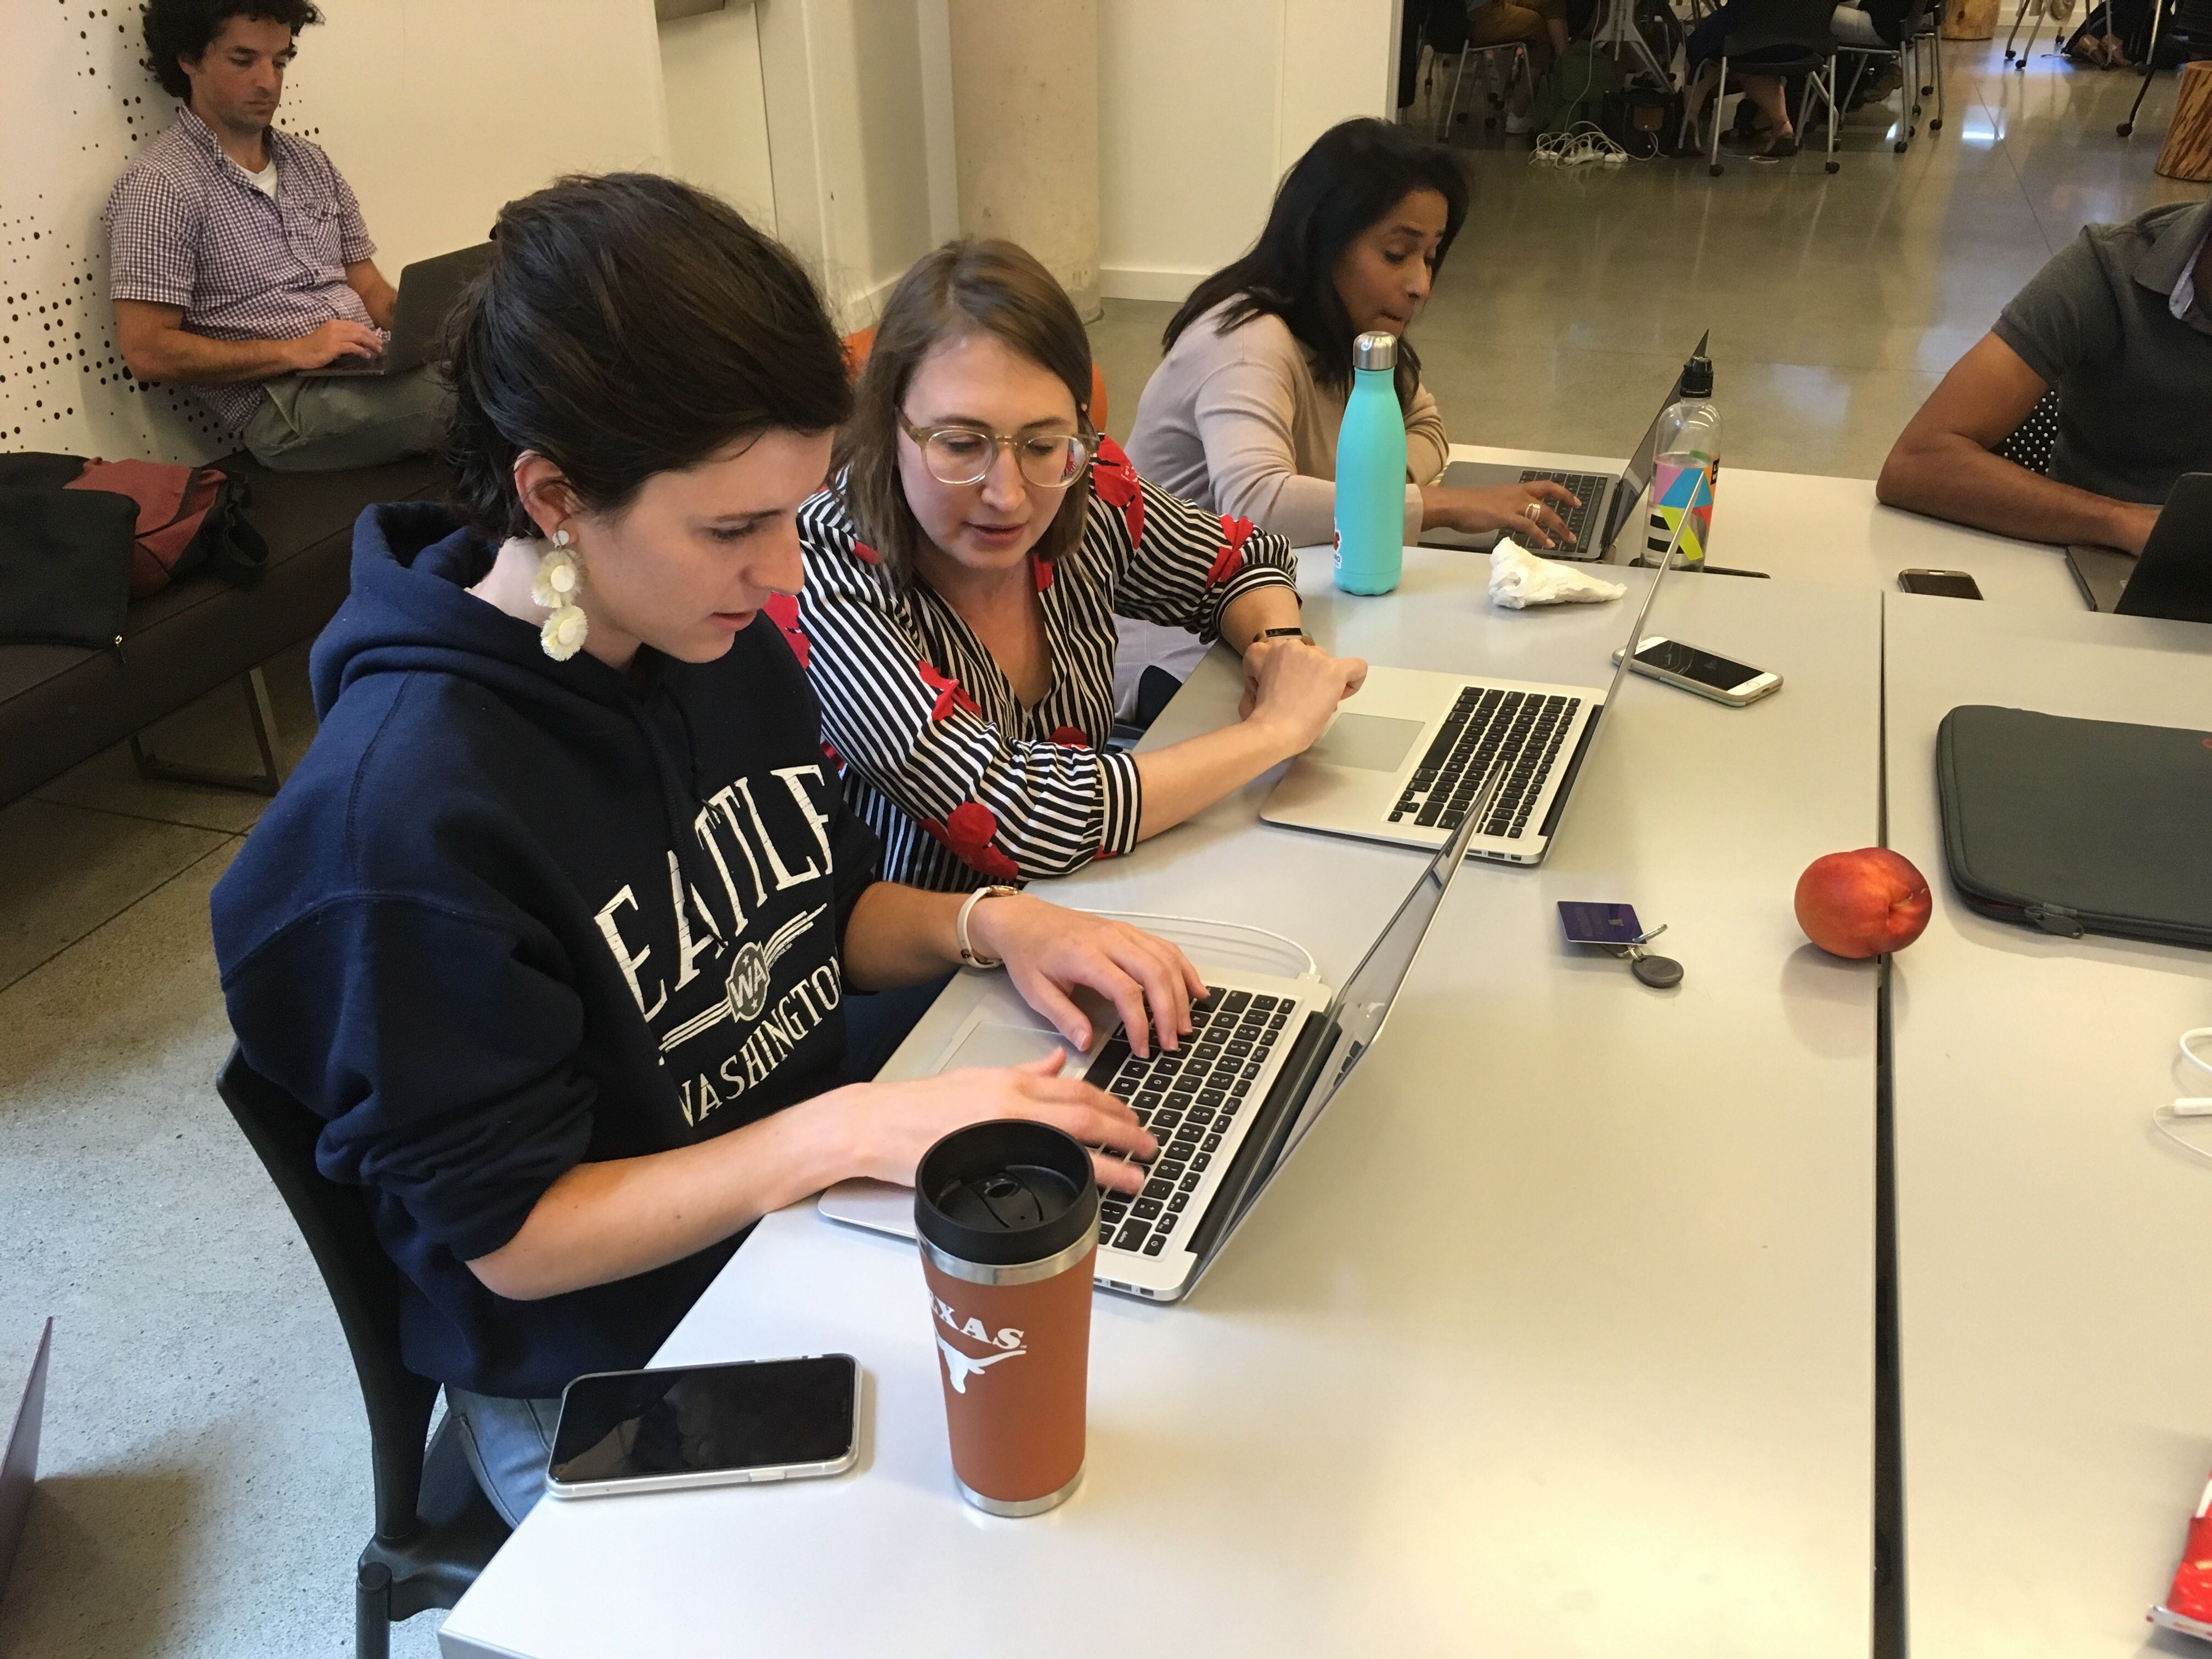
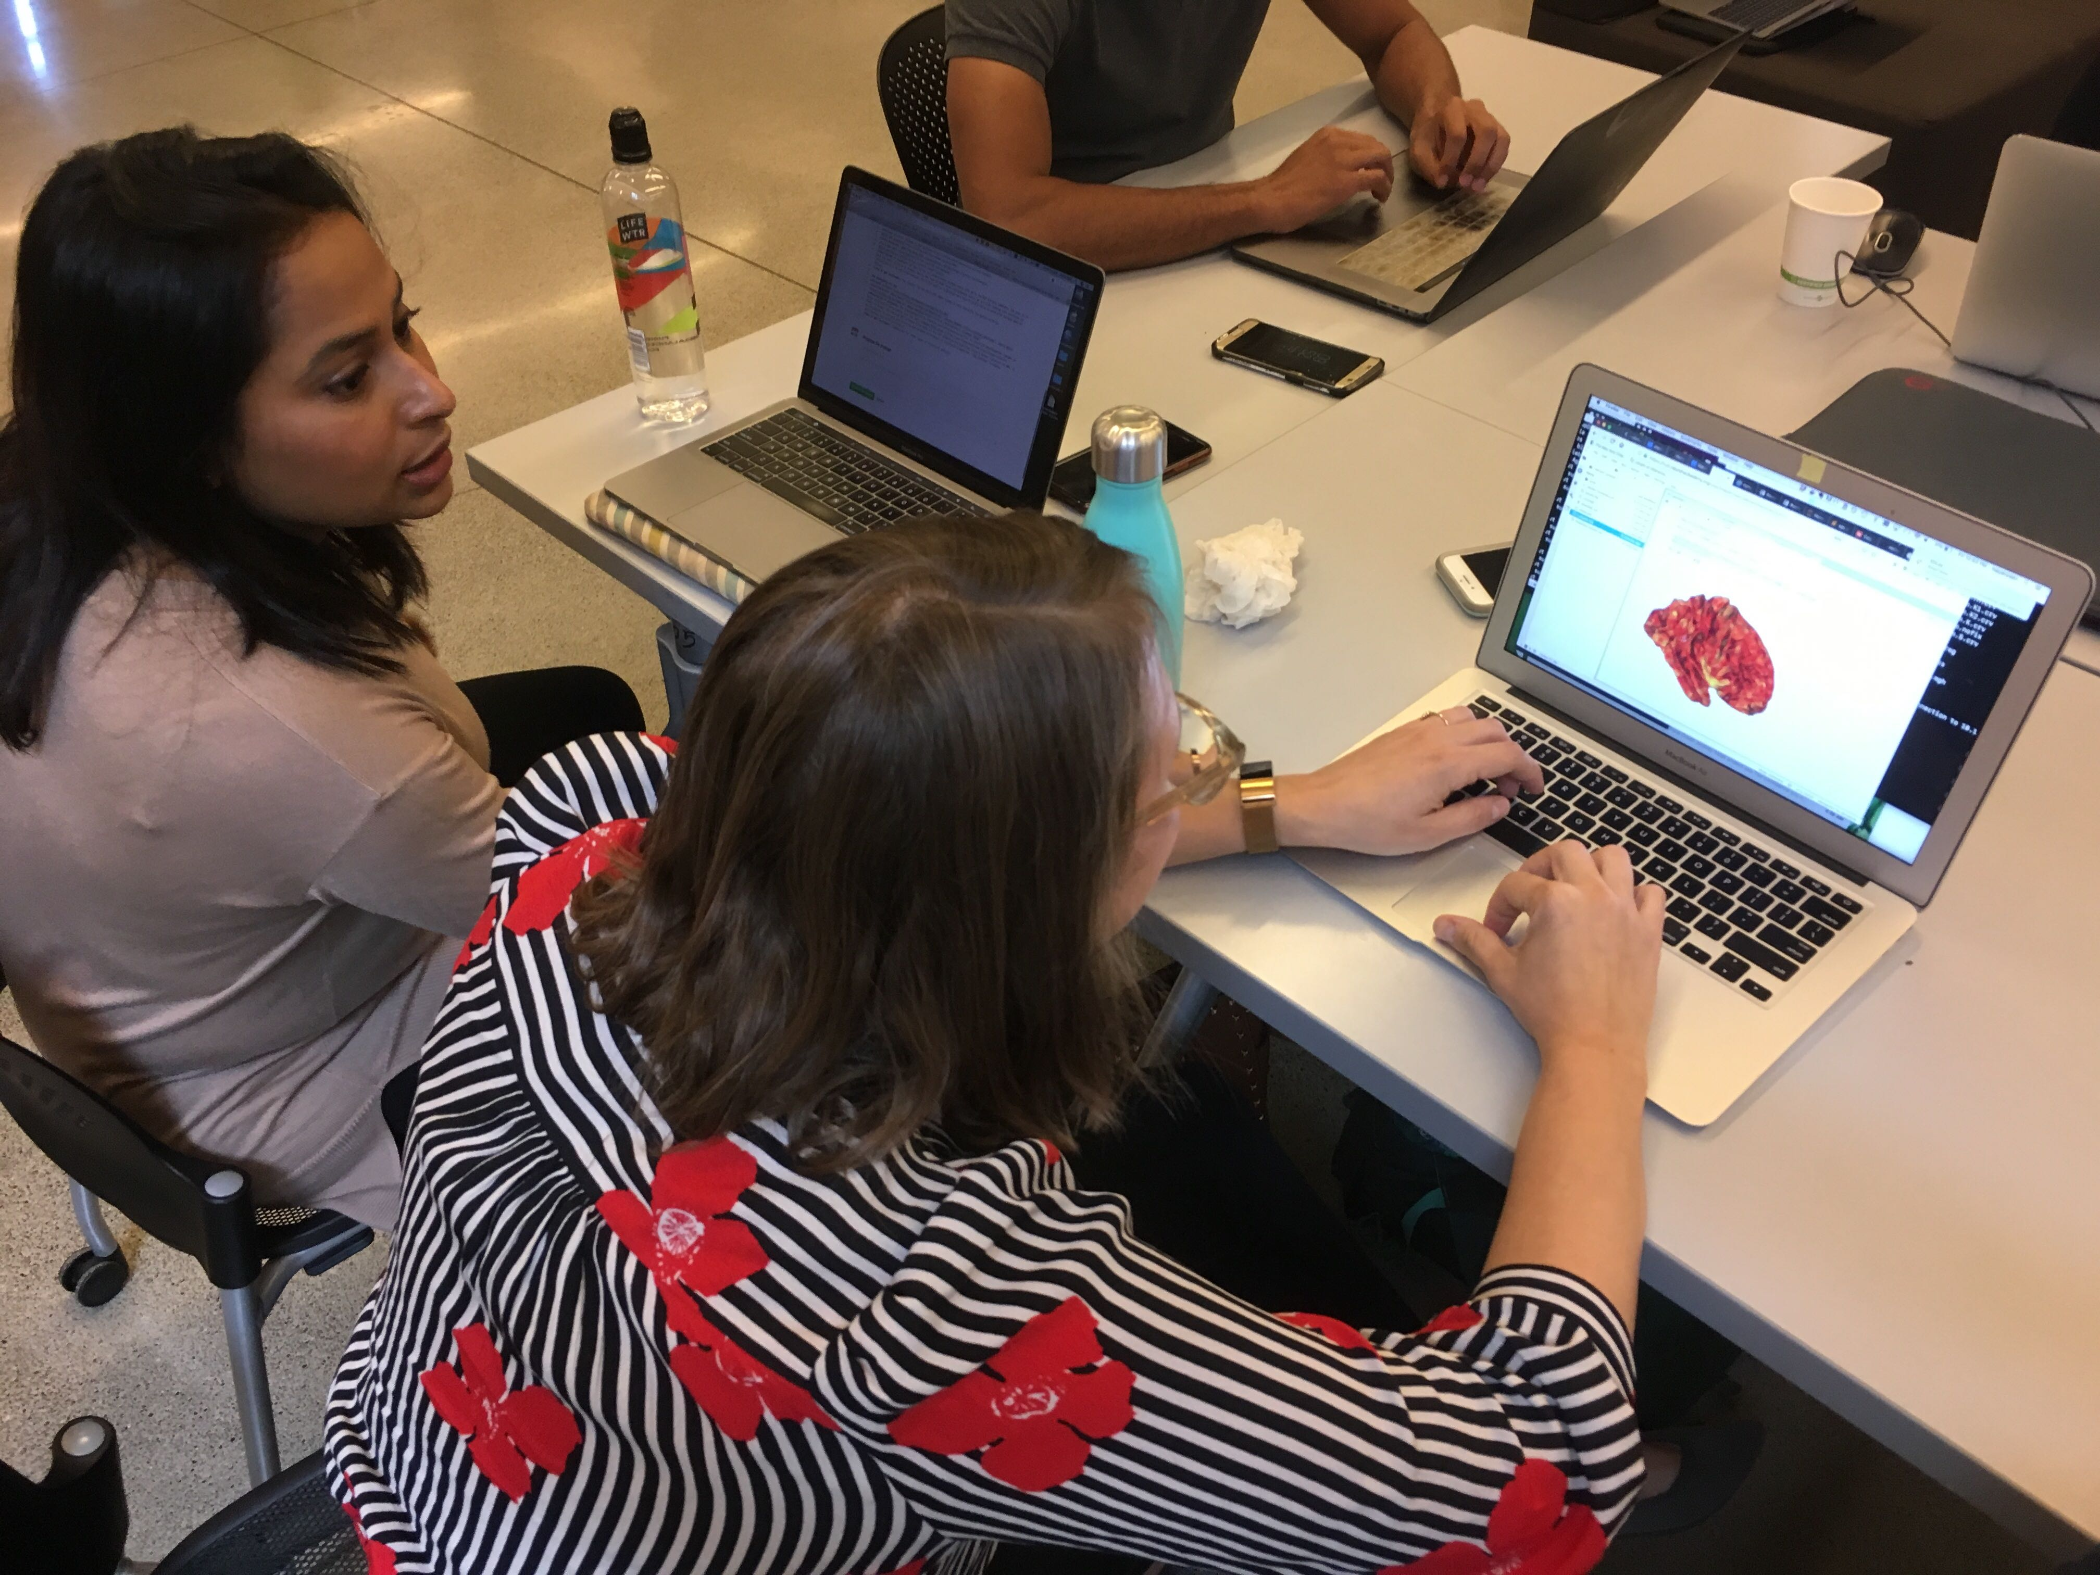
Friday: Actually running group-level analyses in Numpy and visualizing in Neuropythy!

Slide 12
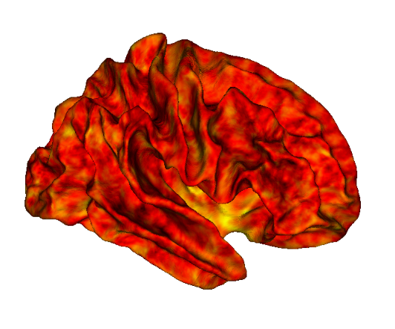
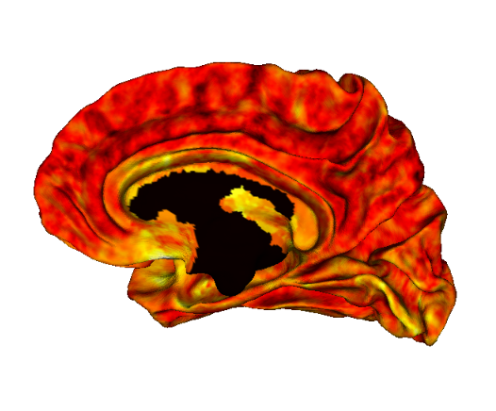
Jupyter Notebook 3

Slide 13
What we learned… and where we’re going.
We learned LOTS about Amazon AWS, Docker, Jupyter Notebooks, and Neuropythy.
We look forward to analyzing the HCP-D and HCP-A datasets using these tools in the near future!
Please give us suggestions for other types of structural analysis (gyrification, TI/T2 differences) and functional analysis (resting state, tasks) are welcome.

Slide 14
THE END

